Slide 1
AI Soccer 3 V 3 Football Game
A Fun Soccer Game Powered by Smart Reinforcement Learning AI

Slide 2
Project Overview
Concept: A 3v3 soccer match controlled by Reinforcement Learning AI.
Teams:
Red Team: Elnemr, Beherry, and their goalkeeper.
Blue Team: Abanoub, ElShokary, and their goalkeeper.
Agents: The players, who are AI entities learning how to pass and score.
Roles:
Attackers: Two players on each team focus on advancing towards the opponent's goal.
Goalkeepers: Each team has one goalkeeper dedicated to blocking incoming shots.
Objective: AI players learn to pass and score, simulating a mini soccer world with intelligent players.

Slide 3
Technologies and Setup
Programming Language:
Python: Known for its simplicity and extensive library support, ideal for AI and game projects.
Libraries:
Pygame: For graphics and animations.
Stable-Baselines3: Trains AI using PPO.
Gym: Structures the AI environment.
NumPy: Manages numerical calculations.
Initialization: Sets up graphics and sound with Pygame for gameplay readiness.

Slide 4
Game Settings
Screen Dimensions: 800 pixels wide, 600 pixels tall.
Player and Ball Sizes: Players are 40 pixels, the ball is 30 pixels.
Team Colors: Red Team in red, Blue Team in blue.
Goalkeeper Colors: Green for Red Team, Orange for Blue Team.
Field Details: Goal areas are 100x200, goals are 120 pixels tall.
Game Duration: 90 minutes simulated in 5400 quick steps.

Slide 5
Model Training
Training Method:
PPO (Proximal Policy Optimization): A reinforcement learning algorithm that helps AI agents learn by taking actions and receiving feedback, balancing exploration and exploitation for stable learning.
Purpose:
Trains a new model if no existing one is found, enabling agents to learn from scratch.
Role for Agents:
Empowers AI agents to predict and execute optimal actions in the soccer game.
Involves learning strategies for effective passing, positioning, shooting, goal-scoring, and blocking like a goalkeeper.

Slide 6
PPO Initialization and Training Parameters
PPO Initialization:
PPO("MlpPolicy", env, verbose=1, learning_rate=0.0003,
n_steps=4096, batch_size=512, n_epochs=20)
Training Parameters:
MlpPolicy: Uses a multilayer perceptron policy for decision-making.
verbose=1: Enables detailed logging of the training process for monitoring.
learning_rate=0.0003: Sets the speed of learning updates.
n_steps=4096: Number of steps before model updates.
batch_size=512: Data size per training update.
n_epochs=20: Optimization cycles per update.

Slide 7
Model Execution and Saving
Execution Process:
Purpose: Trains the model through interaction with the environment over a set duration.
Timesteps Explanation:
300,000 Timesteps: Number of AI interactions with the environment, where each involves an action and feedback to improve decision-making.
Model Saving:
Purpose: Saves the trained model to a specified path, ensuring that the learned strategies and knowledge can be reused without retraining from scratch.

Slide 8
Environment Initialization
Setup: Configures the game field and rules.
Players: Six players with five possible actions: up, down, left, right, kick.
Observations: AI receives 40 numerical inputs about the ball and players.
Visuals: Loads a soccer ball image for the game.
Preparation: Prepares the screen, score, and time display, akin to getting ready for kickoff.

Slide 9
Resetting the Game
Reset Function: Restarts the game to its initial state.
Team Placement: Red Team starts on the left, Blue Team on the right.
Ball Position: Centered on the field.
Speeds: Set to zero for a fresh start.
Game State: Clears previous actions, like kicks or scores.

Slide 10
Observation Space
Information Provided: AI receives 40 numbers to understand the game.
Ball Details: Position and velocity.
Player Details: Distance to the ball, speed, and distance to the goal.
Normalization: Data values are converted to a range of -1 to 1.
Perception: Provides the AI with a comprehensive view of the game.

Slide 11
Actions and Movement
AI Action Choices: Determines actions for all 6 players.
Movement Logic:
Players run towards the ball if far.
Take a shot or change position when near the ball.
Goalkeepers stay near their goals for defense.
Speed: Players move at 5 units, goalkeepers at 4.
Outcome: Ensures strategic and efficient player movements.

Slide 12
Smart Kicking
Goalkeeper Actions: Kick the ball towards the center.
Player Strategy: Pass to teammates or attempt to score.
Kick Power: Adjusts based on distance to target.
Tracking: Keeps track of the last kicker.
Effect: Adds realism and intelligence to gameplay choices.

Slide 13
Physics and Repulsion
Movement: Players and ball move based on velocity.
Friction: Simulates grass by slowing down movement.
Boundary Control: Ensures players and ball remain within field limits.
Repulsion: Prevents players from clustering too closely.
Realism: Mimics real-world soccer physics

Slide 14
Rewards
Reward System:
Proximity to ball: +15 points.
Nearness to goal: +20 points.
Passing to a teammate: +100 points.
Scoring a goal: +1000 points.
Goalkeeper defense: +200 points.
Purpose: Encourages teamwork and strategic play.

Slide 15
Game Loop (step)
Functionality:
Monitors game exit triggers.
Updates player movements and physics.
Tracks time progress up to 5400 steps.
Allocates rewards based on actions.
Detects goals to advance the game.
Objective: Maintains smooth gameplay flow.

Slide 16
Rendering
Graphics: Renders the field, players, and ball.
UI Elements: Displays scores and time.
Game Events: Shows goal messages and halftime notifications.
Frame Rate: Operates at 30 frames per second.
Experience: Provides an engaging viewing experience.

Slide 17
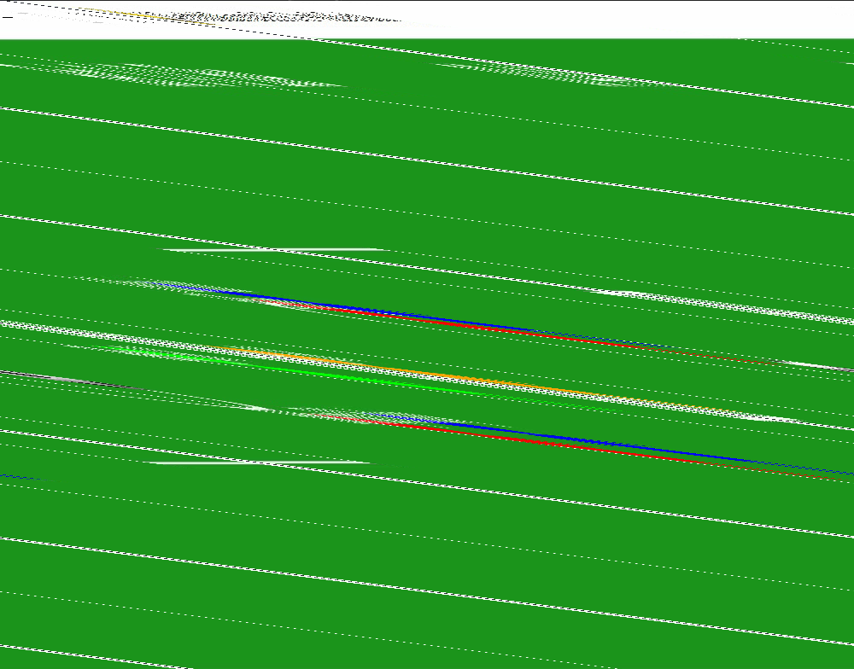
Video Demo

Slide 18
Conclusion
Project Summary:
Developed an AI-driven 3v3 soccer game using Reinforcement Learning.
Trained AI agents to effectively perform actions like passing, shooting, and defending.
Key Achievements:
Created a realistic soccer simulation with intelligent player interactions.
Demonstrated the AI's ability to learn and adapt strategies over time.
Learning Experience:
Gained valuable insights into integrating AI with gaming.

